Slide 1


Pair Testing
and other Radical Ideas
2024

Slide 2

Hi,
I'm Aaron
Notes:
Hi, I'm Aaron. I'm a tester.
And it's been 25 years since I wrote my first defect.
Bug, we called them bugs back then.
I have a QA strategy consulting business, and I'm the test architect at the Massachusetts Medical Society, publisher of the New England Journal of Medicine.
I live in Montana, in the woods.
I work in a yurt – a big round tent – that's my office. It's nice

Slide 3
Pair Testing
and other Radical Ideas
Notes:
My talk is called "Pair Testing and other Radical Ideas."
I want to talk about some practices that were once considered extreme but are now considered mainstream.
I'd like to review the Agile Manifesto and Extreme Programming (this book)
and some other concepts that were maybe radical 20+ years ago
And see how they've lived up to the hype, where they've gone off the rails
And what we can learn by taking a closer look at how they were originally adopted
and what they've become.
Don't worry, this isn't going to be a flame war about how "Agile is the one true process" or "Agile is dead" or anything like that.
This is meant more as a tour of a past perspective (mine), and things we might learn from comparing it with today.
And I'll talk more about Pair Testing, specifically.
How I've done it and how you can do.
Why you might (or might not) want to adopt Pair Testing or revisit any of these old ideas yourself.
And see how they may apply to your QA practices.
And I hope we can have a little fun doing it.
I've accompanied each slide with a pop culture reference from the past
and a short musical clip (if the audio works),
You can play a guessing game (if you want) to see if you recognize them
and can tell how they relate to the topic –
though I admit that the relationship is often tenuous at best and may only exist in my mind.

Slide 4

Back in my day...
Notes:
I don't know when it was that I realized I became a "senior" tester.
That's senior as in senior discount, not like senior prom.
Maybe it's the gray hair or the "dad bod" or the chip on my should because nobody get's my jokes or "references".
It's not that I'm smarter or faster (definitely getting slower) or better than anyone else,
but having been around the block a few times,
I've gained some experience.
Whether I've learned any wisdom from that experience is another matter.
So I'm going to subject you to some nostalgia, and you're going to have to deal with it, or pull me off the stage, or just sit back and enjoy the show.
And get off my lawn, up hill both ways, in 6 feet of snow, and we liked it that way!

Slide 5
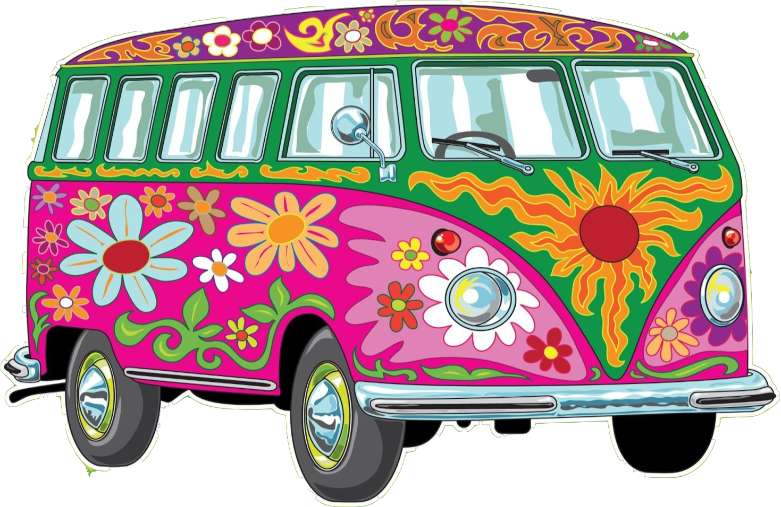
What's old
is new
Notes:
The Byrds - Turn, Turn, Turn
I've seen trends come and go.
Good ideas discarded, bad ideas resurrected.
And, as the philosopher Daniel Laruso said, what goes around comes around.

Slide 6
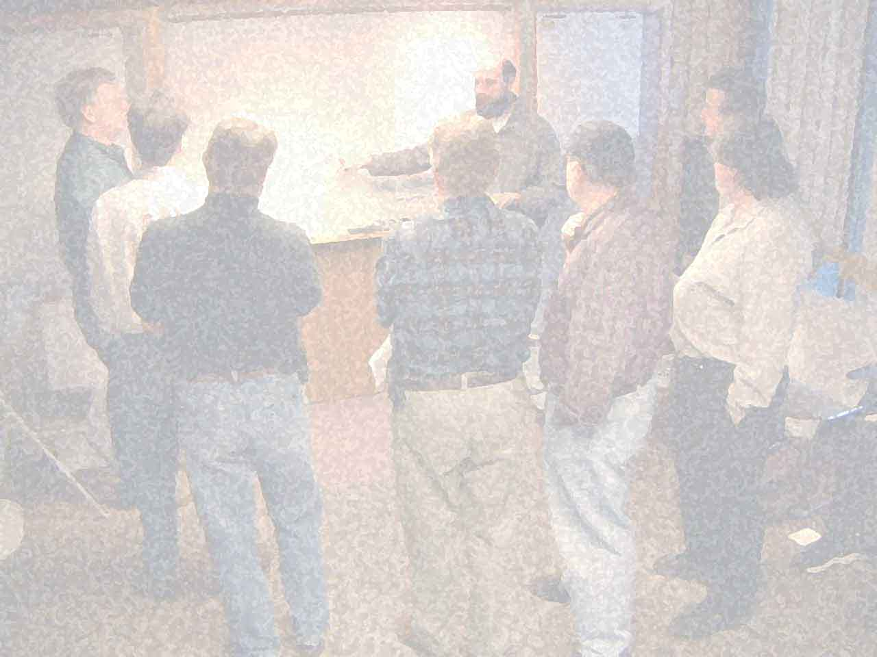
Agile Manifesto
Individuals and interactions over processes and tools
Working software over comprehensive documentation
Customer collaboration over contract negotiation
Responding to change over following a plan
That is, while there is value in the items on the right,
we value the items on the left more.
Notes:
Rage Against the Machine – Bulls on Parade
Back in 2001 a group of 17 people got together at a ski resort in Utah, not to ski but to start a revolution. The outcome of that 3 day meeting was the Agile Manifesto.
They had some common beliefs, but also diverged on what to do and how to do it.
The attendees didn't expect much to come out of their talks, but were pleasantly surprised with the result.
These core beliefs were put forward – with the common theme of
reducing complexity in software development and
being better able to respond to change –
to be more "Agile"
Individuals and interactions over processes and tools
Working software over comprehensive documentation
Customer collaboration over contract negotiation
Responding to change over following a plan
That is, while there is value in the items on the right,
we value the items on the left more.

Slide 7
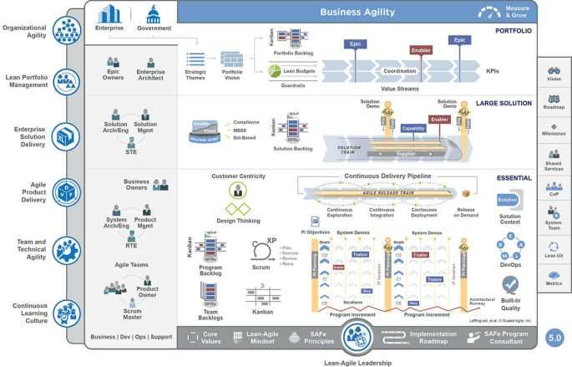
Agile Today
Notes:
Tom Petty & The Heartbreakers – Last Dance with Mary Jane
Let's talk about Agile. And the term "agility". Which wasn’t really in common usage before the Agile Manifesto --
certainly not in software development
It was used as stat in roleplaying games
important when playing a rogue or thief,
or as a more general term for athletes to go along with speed and strength
If you’d have talked about an “Agile Coach” 20+ years, ago,
people would have thought you meant someone who stresses “flexibility” and “nimbleness” to athletes.
Often, what we call Agile today is anything but nimble, flexible, adaptable, or lightweight.
Nowadays, everyone talks about Agile,
it's accepted that everyone "does Agile". Whatever that means.
But has Agile become?
This screenshot in the background is from the Scaled Agile Framework
I'm stealing this from someone else I saw posted online:
Where does the work get done?
That little tiny bullet point that says "Execute"
Someone else pointed out that this is an outdated version of SAFe
That bullet point has since been removed

Slide 8

Extreme Programming
Notes:
The Matrix - Neo
Rob Zombie – Dragula
Where did Agile come from? One of the precursors was Extreme Programming. Kent Beck wrote a book called "Extreme Programming Explained" in 1999.
The year the Matrix came out. It was the 1990s and everything was extreme. Extreme sports. Alternative music.
I think the naming was somewhat tongue in cheek, but the idea was: We have these principles that we know are good, let's turn it up to 11 and take it to the extreme.
Writing tests is a good thing – so let's write our tests first!
Releasing software faster is better – let's do it all the time!
Collaboration is great – let's program together!
Time / Money / Quality // Scope
Pair Programming, Test Driven Development, and Continuous Integration are key components of "Extreme Programming"
Two driving values here were making things simpler and making change easier – with the goals of reducing risk and increasing opportunity.
No waiting months or years and risking a project getting cancelled, work on delivering value and getting feedback rapidly.
Now there are some nutty ideas that go along with this, but there are also some good common sense ideas too.
And you don't have to amp it up to the extreme, maybe 90% volume is enough.
I'm going to talk about pair programming and testing in more detail later. But let's revisit some of these other agile ideas from "the turn of the century". Communication
Simplicity
Feedback Quality
Responsibility
Pair Programming Test Driven Development
Continuous Integration

Slide 9

Scrum
Notes:
The Matrix - Agent Smith
Queen – Under Pressure
The less that's said about scrum, the better. (proceeds to deliver epic rant...)
The term "scrum" comes from the game of Rugby. It describes resetting the ball when it becomes unplayable after an infraction
such as a forward pass or out of bounds,
resulting in a "ruck" or tangle of bodies from opposing sides
where they try to scoot the ball to their backfield players who start running again.
Scrum was first used in "Harvard Business Review" (of all places)
by a pair of Japanese business to talk about product design.
It was adapted in the 1990s by Americans -- Ken Schwaber and Jeff Sutherland (both signers of the Agile Manifesto)
and applied to software development practices.
I don't pretend to know much about Rugby,
but based on how it has been used in software development and project management
I think it's safe to say they don't either.
But there are some useful thing to learn from the process.
The idea of short iterations (or resetting the ball when it becomes unplayable)
And that you should only commit to as much work as you think you can do in that short time frame.
Emphasizing daily, face to face communication –
kept brief by forcing you to stand up through the whole meeting
The (outdated) idea that teams should be cross-functional.
And the concept that periodic rituals with commonly understood names
like "kickoff" and "retrospective"
that encourage frequent team alignment and reflection.
However, the analogies are more apt to American football And I think they'd be better served by talking about "huddles" and "downs" and so forth
Rather than Rugby – a game with literally no rule.
and tactics that are more about wearing the opposing team down with brute force than any cohesive strategy.
There is also that fact that a "scrummage" almost always results in no change in the status quo.
The team given the ball passes it to their "hooker"
who scoots it with his feet behind all the other players
all with their heads down --
into the backfield
and then play resumes as if nothing happened.
Does anybody like scrum? What it has become – a status meeting.
Where a non-manager ask you to report on your progress and say:
"Yesterday I completed ticket 1234 and today I'm working ticket 5678.
While they have a Jira board up showing exactly what you said,
but not long enough for anyone to read it and find out exactly what ticket 1234 does.
The idea that people who understand neither the product or the software should be in charge,
whose management training consists of only a weekend course and payment for a certificate of completion
is beyond laughable.

Slide 10

Test
Driven
Development
Notes:
Vanishing Point
Audioslave – Show Me How to Live
While "Agile" brands including Extreme Programming and Scrum got started before the turn of the century,
it didn't really gain momentum until around 2004. Twenty years ago.
Test Driven Development was probably the most visible of the "Extreme programming" practices.
The idea was that you write tests first, and your tests describe the requirements and document the architecture.
So tests drive development. I think it's a great idea, and I love writing tests first.
I think it leads to cleaner architecture design and helps avoid over-building.
If your tests are correct, and they're passing, your system should be working correctly.
But there's something lots of people don't notice.
The second D in TDD is development.
These are developer tests.
One of the more extreme ideas put forward by Extreme Programming is that these are the only tests needed.
I don't buy that. For 2 reasons:
You can only write tests for what you know. Bugs exist because of what you don't know, not just because of mistakes made by developers.
Developer time is precious. They're good at building software. The assistance that QA can provide not only saves precious developer time, but allows them to focus on what they do best – creating software, while testers can focus on what they do best – breaking it.

Slide 11

Continuous
Delivery
Notes:
Back to the Future
Huey Lewis and the News – The Power of Love
Red, Green. Refactor.
Write a test, watch it fail. Write just enough code to make it pass.
Then refactor the code to make it reliable and maintainable and extensible and probably some other "ibles"
And you'll know your changes work, if your tests still pass.
Continuous Delivery is how you accomplish this.
A lot of developers feel like writing tests (never mind writing them first) is a waste of time.
And it is if you never run them.
But if you run them all the time, and your tests are meaningful (and reliable),
it gives you tremendous confidence and allows you to increase momentum,
because you'll know (almost) immediately when they fail, and (hopefully) what caused the problem.
If you have tests you can count on (both unit tests that check the code – and functional tests that check the business requirements) you can have the confidence to release software faster, and the ability to roll back at the point of failure.

Slide 12
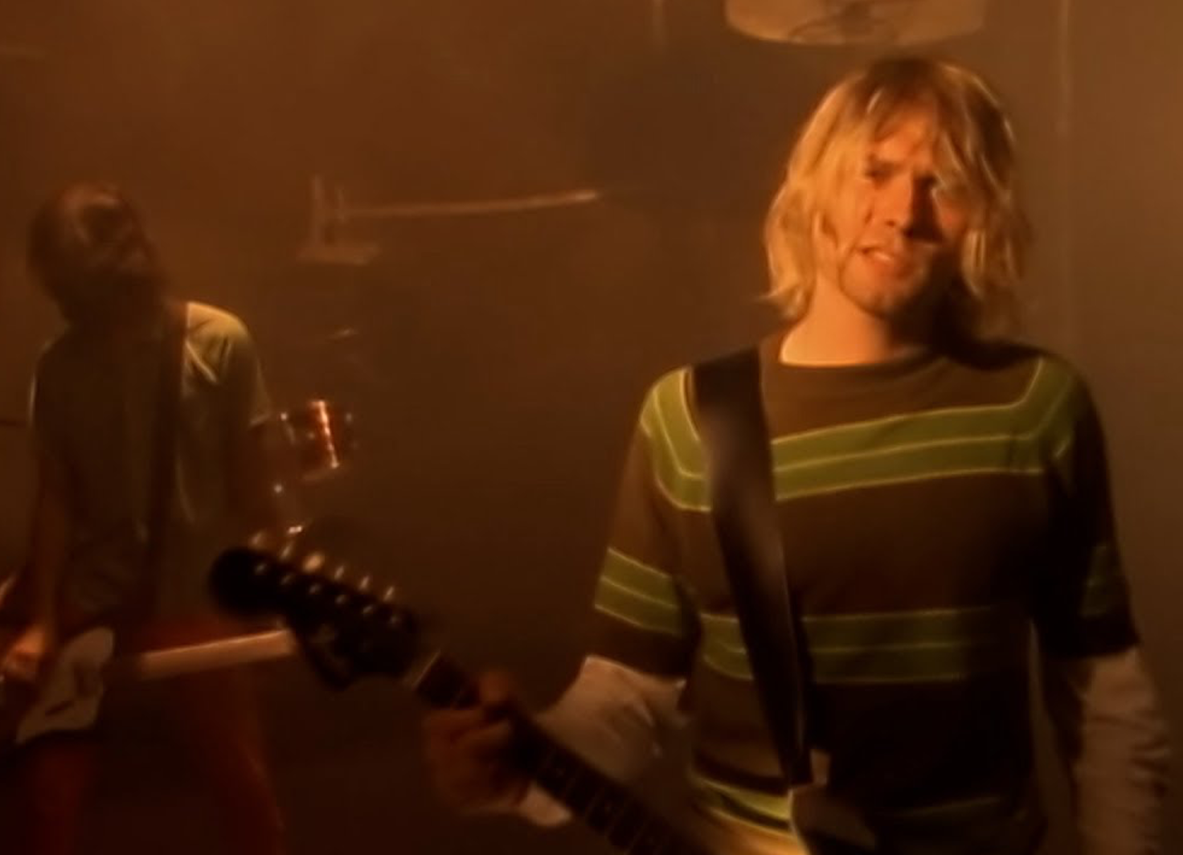
Refactoring
Notes:
Nirvana – Smells Like Teen Spirit
I mentioned refactoring. Tests enable refactoring.
Refactoring is the process of making code that works – still work after you make a change.
If you make a change, and your tests still pass, you didn't break it.
Getting code to work is one thing. Being able to fix it or extend it is another thing.
But if your code is already working, nobody wants to pay for you to refactor it.
Until your code is so complex and tangled that you can't change it without breaking something.
Martin Fowler wrote the seminal book on Refactoring.
But the general idea is to follow simple pattern to make it easier to understand, more extensible, and not coincidentally – more easily testable.

Slide 13

Design Patterns
Notes:
New Order – Bizarre Love Triangle
Design Patterns were all the rage.
You weren't a REAL DEVELOPER (with all caps) until you'd read the Gang of Four book
and implemented an Abstract Factory Observer Builder Singleton Decorator pattern from scratch.
But at a more sensible level, design patterns are just repeatable ways of solving similar problems.
Refactoring code so that you have functions with simple inputs and outputs, not only makes it easier to understand,
it allows you to test it easier, at a lower level.

Slide 14
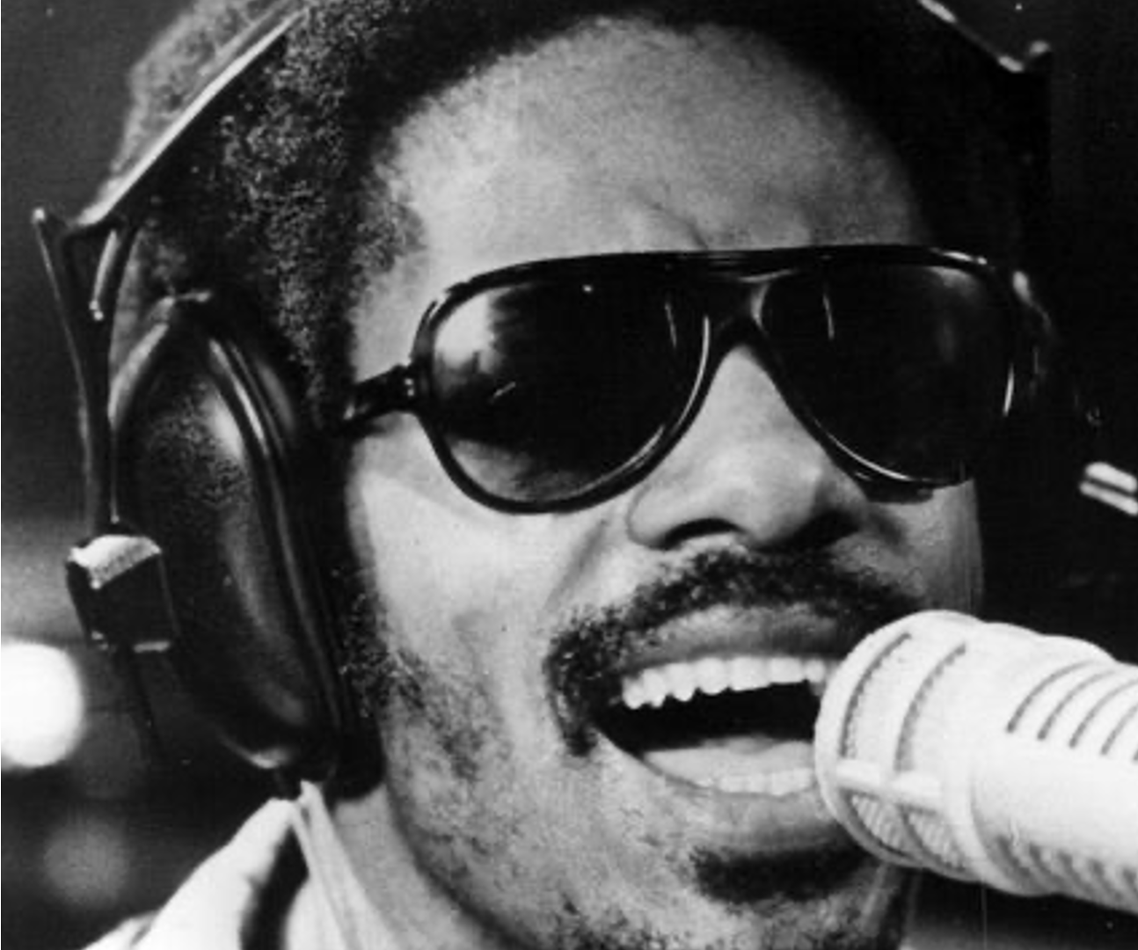
Behavior
Driven
Development
Notes:
Stevie Wonder – Higher Ground
Dan North – JBehave
Aslok Hellosy – Cucumber
Given When Then
BDD wasn't supposed to be about writing tests with those three magic words. It was originally intended as a way to communicate – with customers, with end users.
BDD is supposed to be able people talking to each other, not testers writing automation with awkwardly phrased steps that nobody reads,
with lots of regular expressions.
But there is another part of a user story, that is often forgotten, because it's not automated.
"As a <role> I want to <do something>
So that I can <achieve benefit>
It not only provides context, but gives a reason. If you can't answer this, maybe you shouldn't be building the feature.
Cucumber is just some glue that connects plain English (or whatever language you speak) requirements
with automated test functions. Which is a pretty cool (and pretty simple) idea.
But it's meant to provide examples of behaviors.
If you have "BDD" tests that read
"Given I'm on the home page
When I click on the login button And And And
Then it completes the order" you're doing it wrong.

Slide 15

DevOps
Notes:
Fight Club
The Pixies – Where is my Mind
DevOps was somewhat of a late-comer. At least the term.
But it comes out of the "agile" idea of cross functional teams.
Nobody talks about this.
That developers and operations teams should work together.
That working code and reliable environments cannot exist in isolation. It works for me is no longer an excuse.
You can't have continuous delivery without it.
But somehow, devops has become it's own silo.
This may come from the excesses of the pendulum having swung the other way,
where developers were given the keys to the kingdom
and deployed unscalable, insecure applications to the cloud, and racked up huge AWS bills – even when they didn't expose sensitive data.
I guess all I have to say here, is that there ought to be a middle ground, and can't we all just get along?

Slide 16
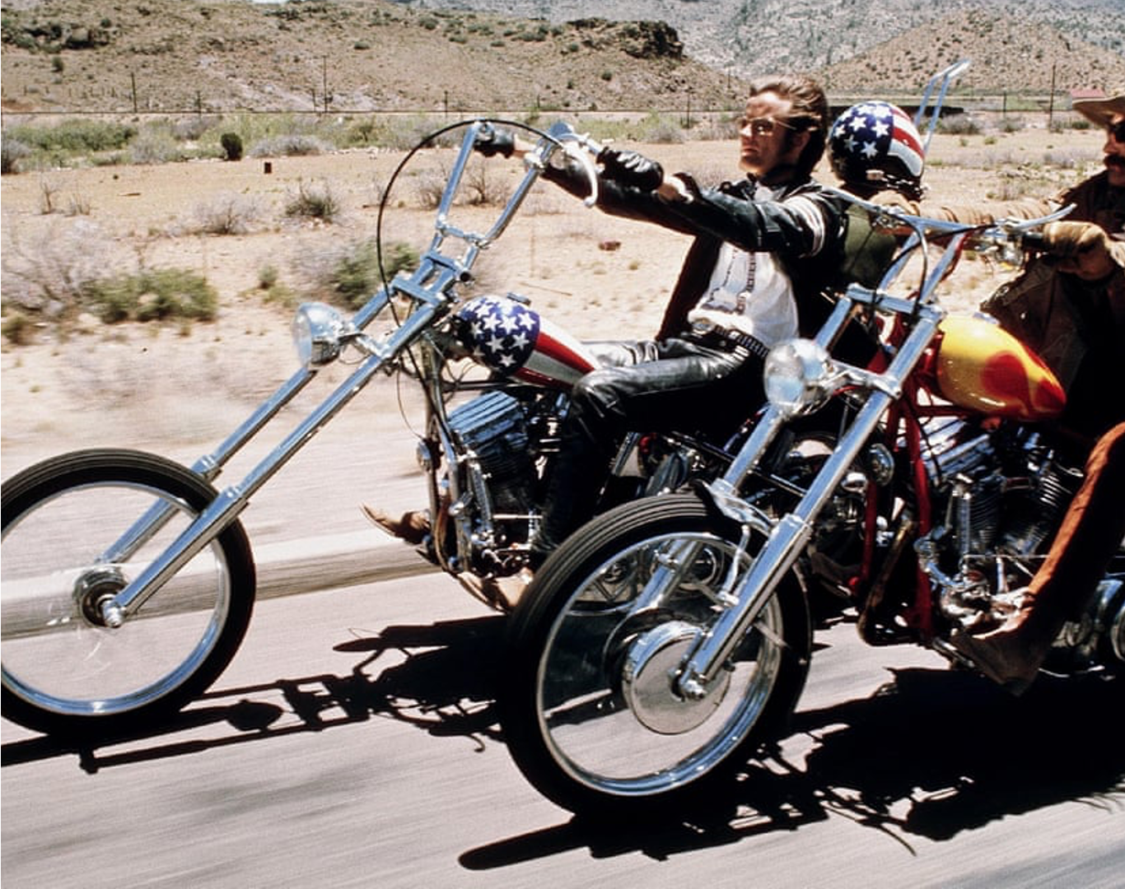
Lean
Principles
Notes:
Easy Rider
Steppenwolf – Born to be Wild
In 2008 the economy crashed.
This time it wasn't because of silly sock puppets selling pet food or overhyped companies selling books or groceries online.
But once again, people started thinking about saving money.
TDD and BDD are supposed to help you build the simplest thing that can possibly work
and Continuous Delivery is meant to get it in the hands of customers as soon as possible
But the Lean Startup, by Steve Blank, asks the question – should we even build it?
Customer Development is the idea that not only should customers be involved in development
but they should be involved before.
Ask them if they would pay for this feature.
Build a minimum viable product and get it in front of them.
Somehow this became – build a fancy landing page and some mockups and sell vaporware.
But there is a good idea in here.
Code costs money to maintain, and the more code you have, the more complexity you have, and the more potential bugs. Less code, fewer bugs, less cost. Lean came out of Japanese auto manufacturing.
The goal is to eliminate waste.
Wasted time and materials.
On an assembly line, a stoppage means people are standing around.
But even worse, a defect found after release can result in lawsuits, recalls, and bad reputation.
Kanban
Take one task at a time
Pull the chain
Anyone can stop production if they see an issue
Trust your employees to do the right thing
Empower them to make a difference in quality, and efficiency.

Slide 17
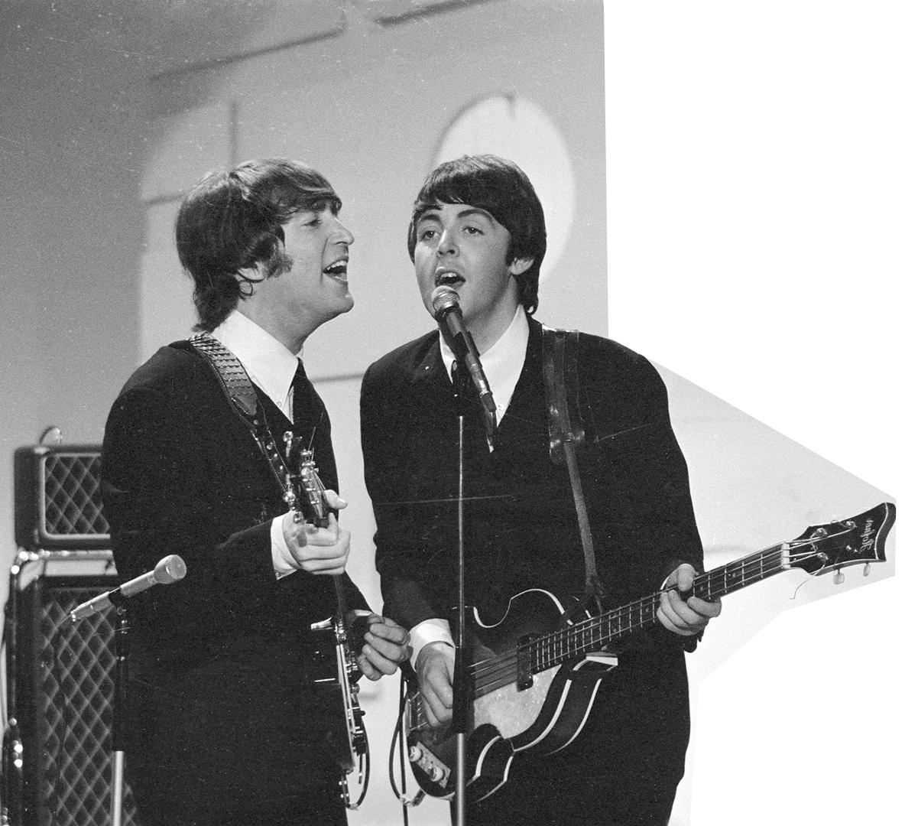
Pair
Programming
Notes:
Help – The Beatles
Norwegian Wood
And finally, we get to pair programming.

Slide 18


Slide 19

Pair Testing
WHAT IS IT
Like Pair Programming
But not necessarily
Two (or more) people
working together on a task
and communicating (in real time).
(usually) one leads and the other follows
taking turns & collaborating
Notes:
Beatles – Come Together

Slide 20

Pair Testing
WHO TO PAIR WITH
Other Testers
Developers
DevOps / SRE
Management / Product / Customers
Support
Senior / Junior
New / Old
Manual / Automation
Notes:
Baba O'Reilly – The Who
Who can it be now – Men at Work
Who can do it?

Slide 21
Pair Testing
WHAT TO DO
Find bugs / Troubleshoot issues
Research / Exploratory Testing / Usability
Writing and fixing automation
Complimentary Tasks
Proofreading Code / Deploy / Run Test / Check Results
Documentation
Code Reviews
Interviews
Notes:
???
So how can you do pair testing? And what can you do effectively?
Any task that involves communicating is great for collaborating
Whether it's in person, sitting side by side, or just looking over someone else's shoulder
It doesn't have to be writing code
It can be exploratory testing This works well coupled with automation
Or any two complimentary tasks
Find bugs / Troubleshoot issues
Research / Exploratory Testing / Usability
Writing and Fixing automation
Complimentary Tasks
Code / Deploy / Run Test / Check Results
Proofreading / Documentation
Refactoring

Slide 22
Pair Testing
WHY
Find bugs / Troubleshoot issues
Research / Exploratory Testing / Usability
Writing and fixing automation
Complimentary Tasks
Proofreading Code / Deploy / Run Test / Check Results
Documentation
Code Reviews
Interviews

Slide 23
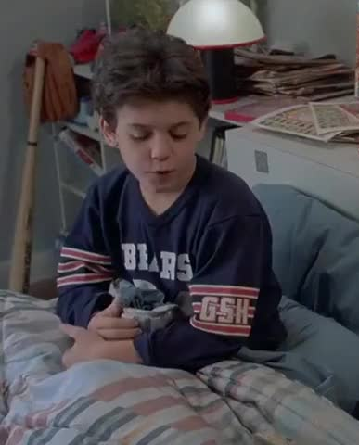
Pair Testing
Concerns
Waste time/resources
Less productive
Duplication of effort
Nervousness
Personality conflicts
How to do it effectively
Notes:
The Clash – Should I Stay or Should I Go?
Pair Testing Concerns
Is it a waste of time
or inefficient use of resources
Couldn't we be getting twice as much done with two people working independently?
It's less productive People are talking or goofing off Not getting work done
Can you work effectively together
Communication
Are you nervous having someone watching you? Judging your typing skills Or your need to look up how to do something?
How can you measure the effectiveness of Pair Testing?

Slide 24

Pair Testing
Benefits
More eyes
Fun
Motivating
Focus
Distribute work (different tasks)
Share knowledge
Notes:
Pet Shop Boys – Opportunities
Pair Testing Benefits
When you work together
More eyes
Two heads are better than one
Personally, I think it's fun.
It's a social activity that helps to break up a monotonous day.
It's motivating to work together,
and helps me be more productive by having someone to keep me focused on the task
And while I'm doing one think – looking for an XPATH locator for automation
my partner can be figuring out the expected API status code or database query to validate a result.
Just having someone to catch obvious typos or logical inconsistencies,
suggest better variable or function names,
or a refactoring that makes something simpler
or a show new tool or pattern or technique that I might not know about.

Slide 25

Pair Testing
How to do it
In person
Remote
Slack / Teams
Screen Share
Coding tools (next)
Asynchronous (git)
Notes:
Whitney Houston – How Will I Know?
So how can you do pair testing? And what can you do effectively?
Any task that involves communicating is great for collaborating
Whether it's in person, sitting side by side, or just looking over someone else's shoulder
Good tasks

Slide 26
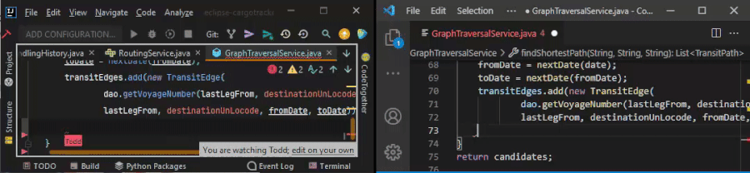
Pair Testing
Browser based (CodeAnywhere, CodeTogether)
IDE plugins (Jetbrains, VSCode, neovim)
Tools
Notes:
Peter, Paul, and Mary – If I had a Hammer
Pair Testing Tools
Remote pair testing wasn't always a possibility.
But thankfully remote tools have progressed a lot recently.
A simple screen sharing tool like TeamViewer
Meeting software like Zoom or Microsoft Teams
Browser-based code editors like CodeAnywhere
IDE plugins
CodeTogether
Jetbrains – Code With Me
VS Code – Live Share There are even vim plugins
Using git with slack or another chat program

Slide 27

Pair Testing
Make It Happen
Start with a goal
Communicate: talk out loud!
Take turns
Timebox
Have fun!
Notes:
Captain Picard – Star Trek Next Generation Theme
Making it happen
Start with a goal
Communicate: talk out loud!
Take turns
Timebox
Have fun!
Don't worry about rough starts, it will get easier as you
get to know each other
gain practice using tools and communicating better
Lose awkwardness or fear with repetition
Learn to not judge

Slide 28

Mob Testing
& Bug Bashes
Plan ahead
Send meeting invites
Make sure environment is ready
Brief everyone
Status updates
Rewards & acknowledgement
Notes:
Will Smith - Men in Black
Mob Testing & Bug Bashes
Plan ahead
Send meeting invites - publicize the event
Make sure environment is ready
Brief everyone - give goals
Status updates - slack channel
Rewards & acknowledgement - thank them!
Give rewards for most bugs found, most creative issue found, stupidest question Treats or T-shirts or swag for all participants are nice
Not everyone has to a domain expert
or a technical expert or a professional tester
fresh eyes are good
Mob Testing is like pair testing, but will more people
It can get chaotic
Set ground rules for communicating
Have a facilitator to coordinate

Slide 29

AI &
Rubber Ducks
Notes:
Mr. Roboto – Styx
AI & Rubber Ducks
If you grow to depend on AI, you're in trouble
The copilot pause
Passive instead of thinking
Boilerplate
Confidently inaccurate and hallucinations
About 25% of the time
AI works well as a tool
to help you research
Gain a layout of the land
Summarize data
Look up source material
Do your your own sanity checks
Use it to help you think clearly
What is a rubber duck? Or duck testing?
Someone (or something) to help you talk through a problem. Think out loud.
Ask the stupid questions – like "why?"

Slide 30

Invitation
Notes:
Top Gun - Theme song
If you can't find someone to pair with,
give me a call
I'll test with you
I love to pair test

